Slide 1

APEX INSTITUTE OF TECHNOLOGY
DEPARTMENT OF COMPUTER SCIENCE & ENGINEERING
Computer Organization & Architecture (21CSH-281)
Faculty: Siddharth Kumar (E12853)
Lecture – 29 & 30
Memory Organization: Replacement Algorithms & Write Policies
DISCOVER . LEARN . EMPOWER

Slide 2
Computer Organization & Architecture: Course Objectives
COURSE OBJECTIVES
The course aims to:
The purpose of the course is to introduce principles of computer organization and the basic architectural concepts.
It begins with basic organization, design, and programming of a simple digital computer and introduces simple register transfer language to specify various computer operations.
Topics include computer arithmetic, instruction set design, microprogrammed control unit, pipelining and vector processing, memory organization and I/O systems, and multiprocessors.
To familiarize Students with the detailed Architectures of a Central Processing Unit.
Learn the different types of serial communication techniques.

Slide 3
COURSE OUTCOMES
On completion of this course, the students shall be able to:-
CO1 | Identify and interpret the basics of instruction sets and their impact on the design, organization, and functionality of various functional units of a computer comparable to the CPU, memory organization, I/O organization, and parallel processors.
CO2 | Analysis of the design of arithmetic & logic unit and understanding of the fixed point and floating-point arithmetic operations.
CO3 | Relate cost performance and design trade-offs in designing and constructing a computer processor which includes memory.
CO4 | Understanding the different ways of communicating with I/O devices and standard I/O interfaces.
CO5 | Implementation of control unit techniques and the concept of Pipelining.

Slide 4
Cache Replacement Algorithms
Cache replacement algorithms specifies different ways to evict an item from the cache with it is full. There are bunch of algorithms available used in different scenarios. The goal is to understand different cache replacement policies by implementing simpler version of these algorithms.
Optimal Replacement: The best algorithm is called Bélády’s algorithm because it’ll always discard an item from the cache if it is no longer needed in future. Of course this is theoretical and can’t be implemented in real-life since it is generally impossible to predict how far in the future information will be needed.
FIFO/LIFO: In FIFO the item that enter the cache first is evicted first without any regard of how often or how many times it was accessed before. LIFO behaves in exact opposite way - evicts the most recent item from the cache.
Least Recently Used (LRU): Here we replace the item that has been unused for the longest time. Implementation is almost same as FIFO cache - used a map and doubly linked list. Only difference is that any time there is a cache hit, we move it to the front of the queue. Items at the front are most recently used items and items at the tail are the least recently used items.

Slide 5
Least Frequently Used (LFU): In LFU, we count how many times an item was accessed and evict the item that has least access count. I used a map and a minimum priority queue to implement it. Priority queue sorts the items in a binary tree based on their hit counts. Item at the root of the heap has the least hit count. Instead of removing the root, we update it’s values and reset hit count and Fix the tree. calling heap.Fix() is equivalent to, but less expensive than, calling heap.Remove() followed by a heap.Push()of the new value.
LRU and LFU combined: Finally let’s combine LFU and LRU together so that when multiple items in the cache have the same hit counts, we’ll only evict the oldest one. We can modify the LFU implementation a bit and add a global sequential id to each item. When accessing/adding an item we increment the id and store it in the item. So the items that are recently accessed will have a higher sequential ids than the older ones.
Cache Write Policy: A cache’s write policy is the behavior of a cache while performing a write operation. A cache’s write policy plays a central part in all the variety of different characteristics exposed by the cache.
As shown in the above figure, the address from processor is divided into two field a tag and an index.

Slide 6
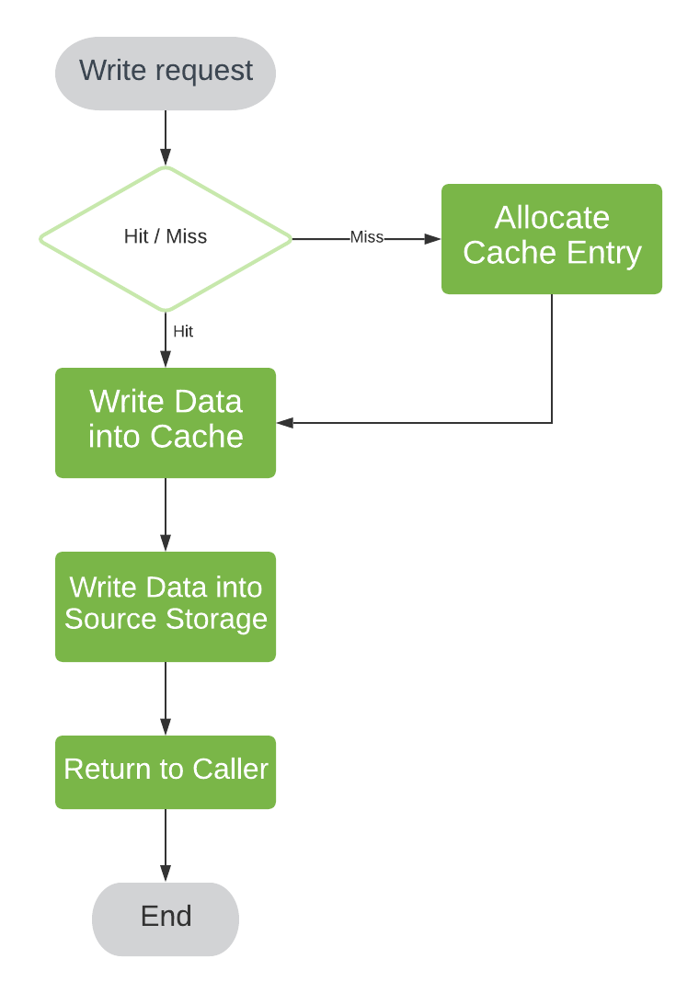
Let’s now take a look at three policies:
• Write-through
• Write-around
• Write-back
1. Write-through: Suppose we design our
cache to ensure consistency first. That is,
we’d want to update our backing store
synchronously before sending the response
back to the client. In case the requested
entry is not found in the cache, we create an
entry in cache storage first:

Slide 7
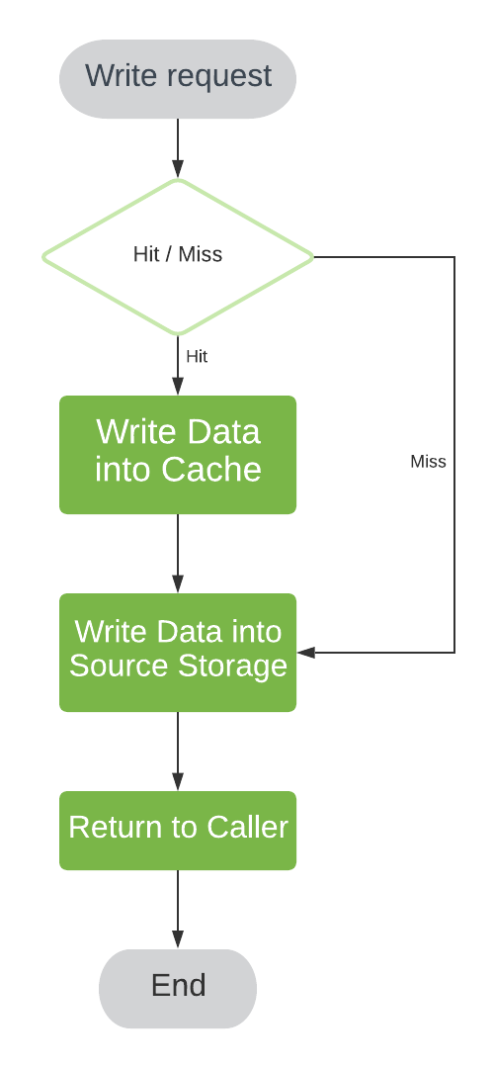
2. Write-around: Now, write-through provides the best outcome in case we expect written data to be accessed soon. Depending on our cache usage pattern, this might be not true.
If we do not expect a read operation shortly after, the cache would become polluted with the entries we’re not using. To avoid cache pollution, we may bypass cache entry allocation in case of a cache miss:
We refer to this policy as “write-through with no-write allocation” or write-around.
Yet another variation on write-through cache is write-invalidate policy. In this mode, along with the write operations going directly to the backing store, cache data entry undergoes invalidation in case of a cache hit.

Slide 8
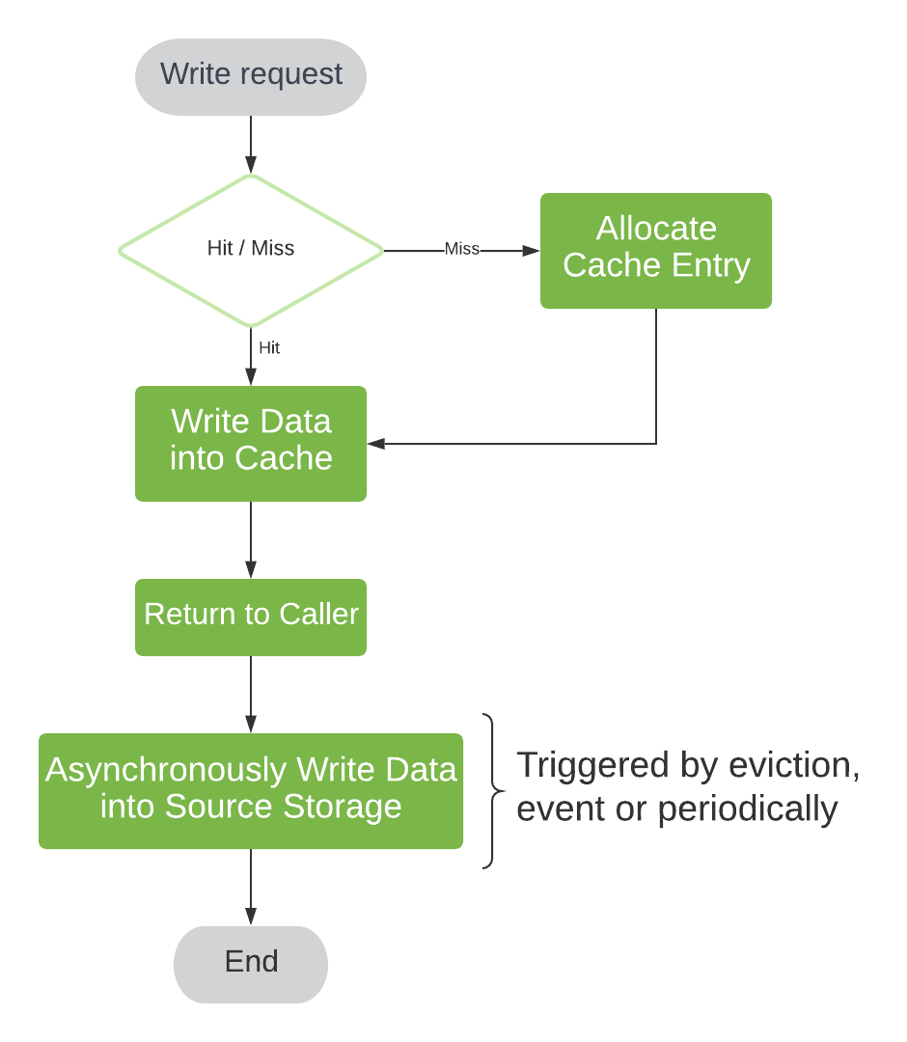
3. Write-back: While write-through provides us the best consistency, it does not help us with write operation latency – the cache returns a response to the client only after the backing store is updated.
We may take advantage of our fast cache storage to streamline this as well. To do this, we would have to return the response before updating the backing store. In this case, the backing store update happens asynchronously in a separate sequence.
We can kick off such a sequence in several ways – right before the response return, periodically, or integrated into cache eviction based on cache entry dirty state. For CPU caches, we use a dirty bit as a state indicator. In software caches, asynchronous kick-off before response return is generally preferable.
We call this type of policy write-back or write-behind:

Slide 9
The asynchronous update brings us better responsiveness as well as the chance to improve throughput, for example, using source storage update batching.
Besides write-back having more difficult implementation, it’s possible to encounter consistency issues. Having cache in volatile memory, power outage before write-back is complete would result in data loss.
More subtle issues also emerge in write-back implementations. Consider when we access source storage not only via our cache instance but using some other means as well – either by another cache instance(s) or a direct write operation. The data which is not written to the backing store yet may reach the store only after the direct write operation is completed.
To ensure this does not happen, we must preserve operation order at some level. We call this technique transaction serialization.
Considering both the set of techniques to address this kind of problem and the concept itself we use the term cache coherence

Slide 10
Summary
Discussed about the replacement algorithms.
Discussed about the Write policies.
Assessment Questions
Q1. What are the types of replacement algorithms?

Slide 11
THANK YOU

